Slide 1
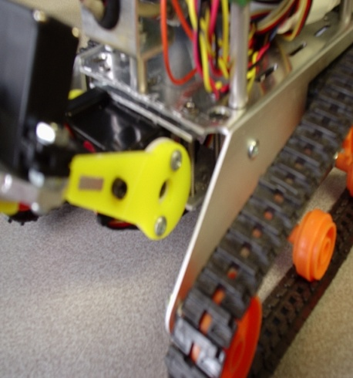
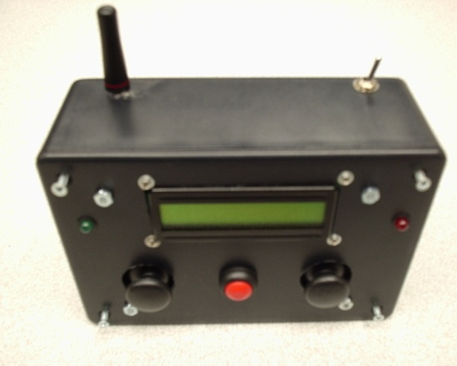
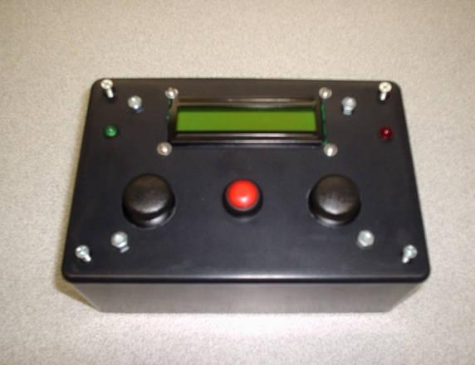
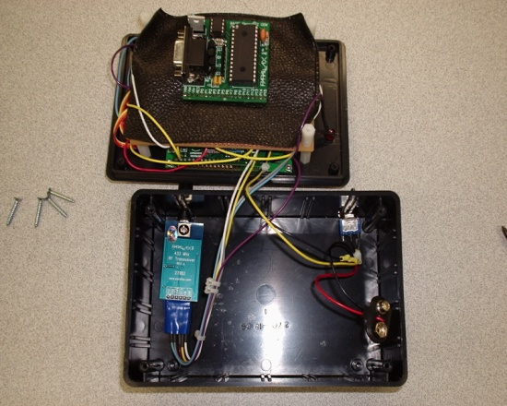
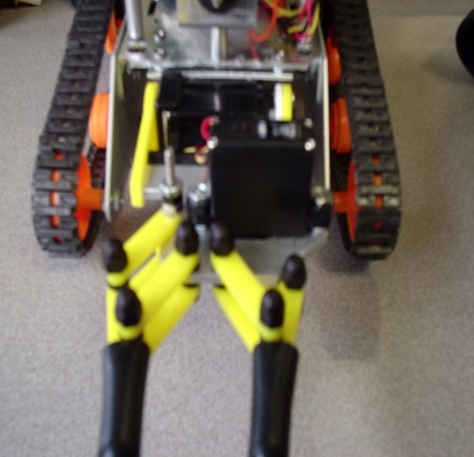
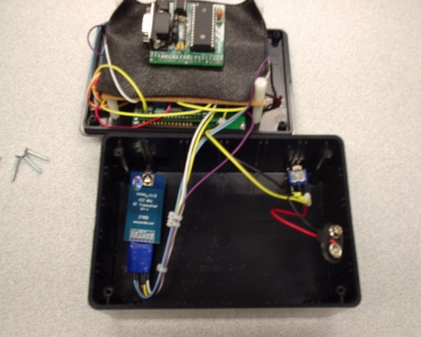
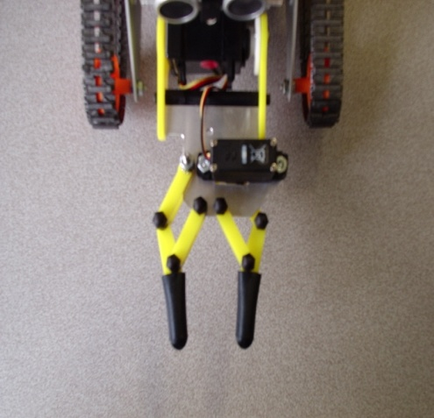
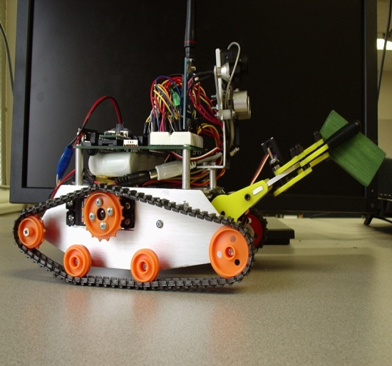
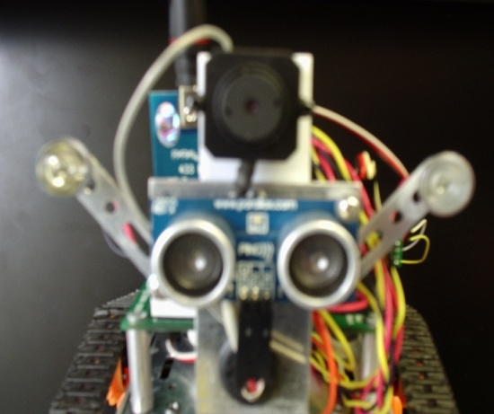
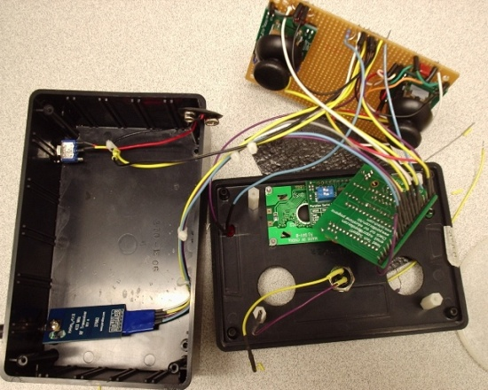
Rover-bot
By: Brian & Charlie

Slide 2
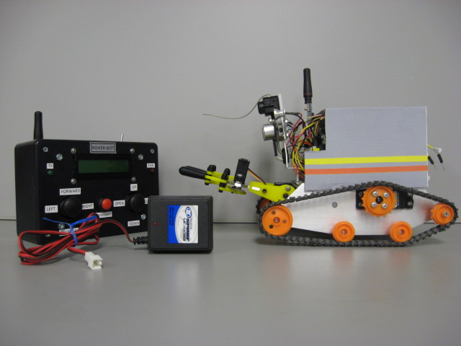
Project Objective
The project was to build a wireless remote control vehicle that has the capability of moving objects to different locations in the room and drop them into a designated place.

Slide 3
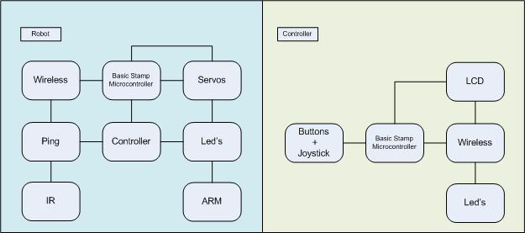
Block Diagram

Slide 4
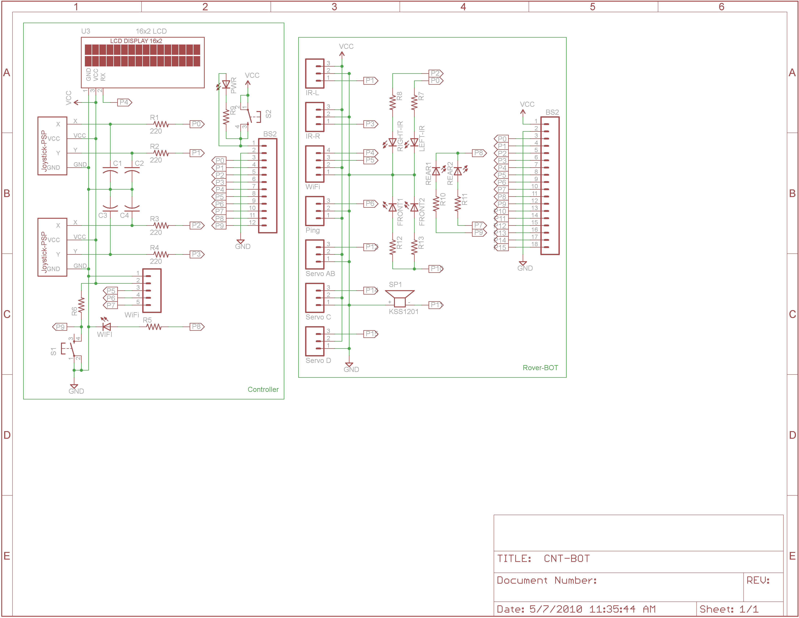
Overview of Circuitry

Slide 5
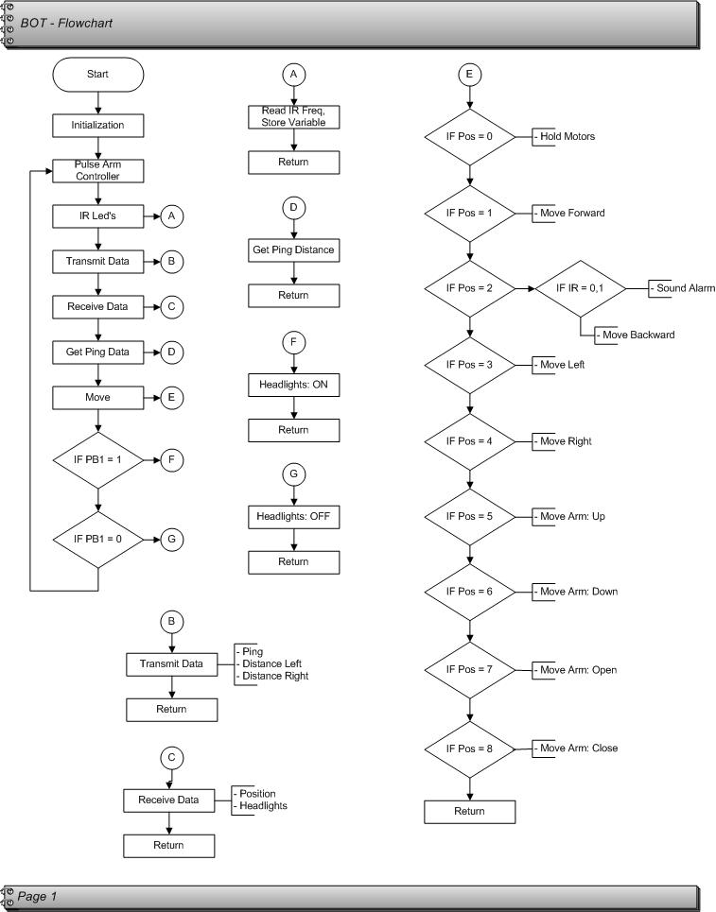
Operation & Flowchart

Slide 6
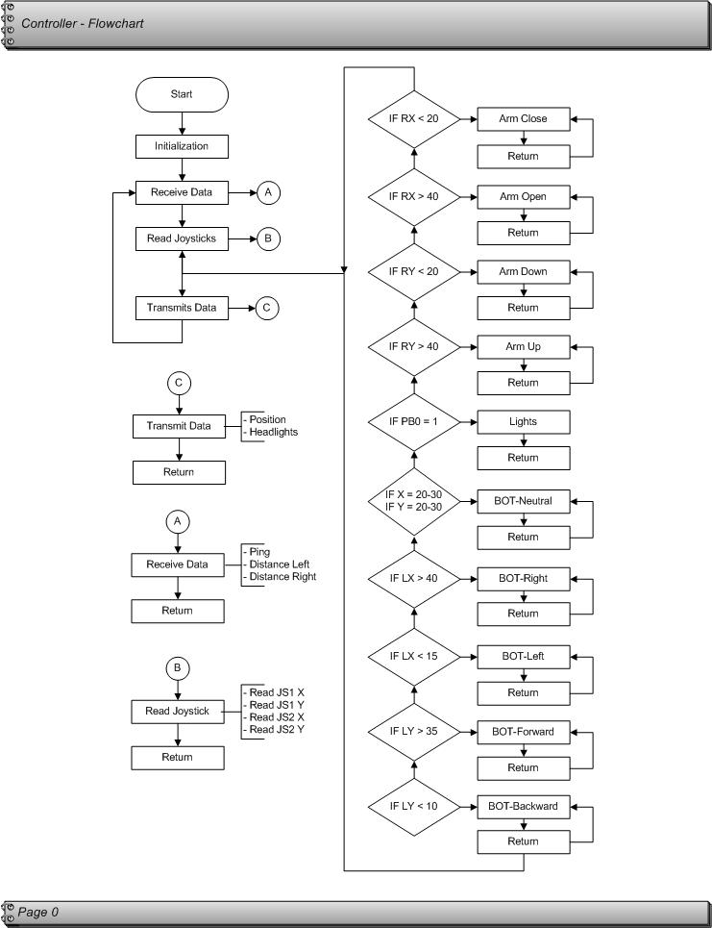

Slide 7
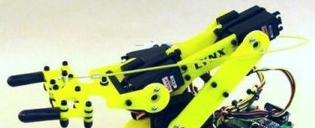
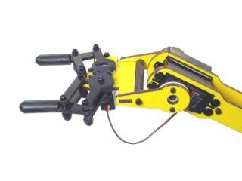
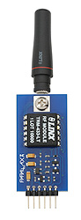
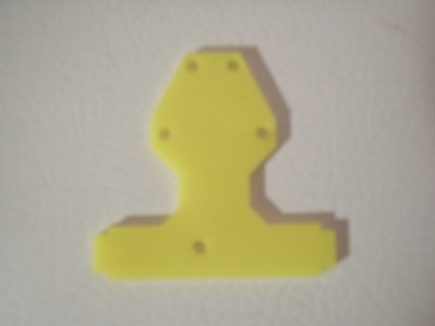
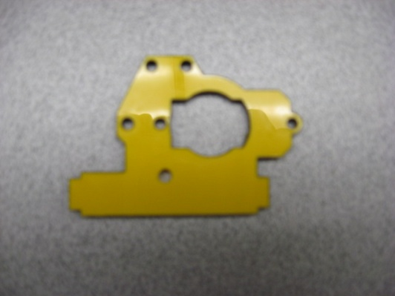
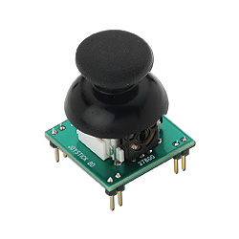
Issues Encountered
Arm:
Robot:
Original Design
Modified Version
Unreliable Operation
Unstable Servo Pulse
Two Way Communication
Original Plate
Needed Plate
Controller:
XY Comparison Values
RC Time-Constant vs. Variable

Slide 8

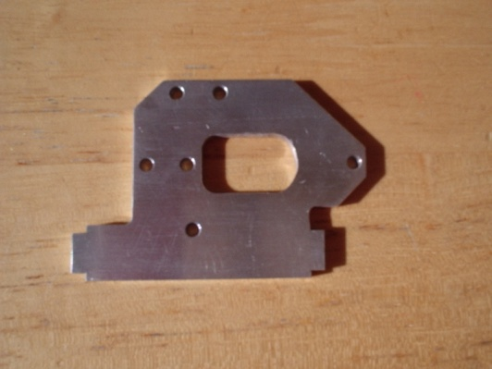
Problems Overcome
Arm:
Robot:
Original Design
Our Version
Used a Micro Servo and
Microprocessor
1. Analyzed Code Section
2. Attempted Several Code Modifications
3. Found out it was:
Order of Operation
Original Plate
Plate Designed
Controller:
Use 2 Values per Axis
Sending less Data across Wi-Fi

Slide 9
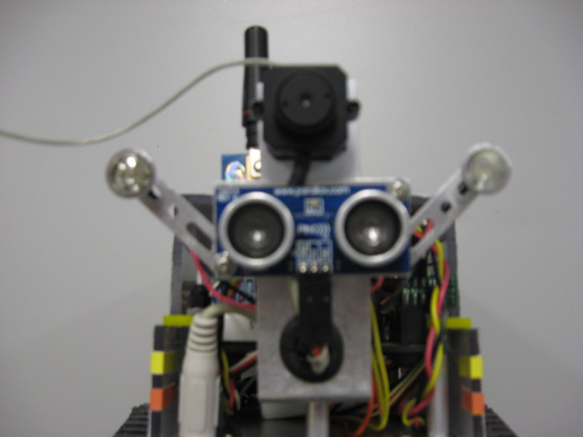
Additional Add-ons
Camera

Slide 10
Questions

